Slide 1
Arcade Application
By: Alec Levin
in collaboration with: Eric Mott

Slide 2
Motivation
Android devices have many different capabilities that a developer can take advantage of, such as:
Gyroscope
Accelerometer
GPS
Camera
Microphone
Internet Connectivity (Cloud API’s)
The question I faced: what sort of application might allow me to gain experience using as many of these features as possible in a fun way?

Slide 3
Pitch
A single Arcade Style application that allows a user to pick an activity from a suite of games

Slide 4
Specific Features
A simple ball-in-hole type game
A voice modulator
A vertical platform game (Doodle Jump)
One or more simple games
Two person tic-tac-toe
Minesweeper
Tetris
2048
Individual user identities through Google accounts
Fun and relevant Statistics such as how long each user has played each game or their high scores

Slide 5
Device Requirements
Android 5.0
Gyroscope and/or Accelerometer depending on implementation
Camera
Microphone
Internet
Size Estimate: 5 MB

Slide 6
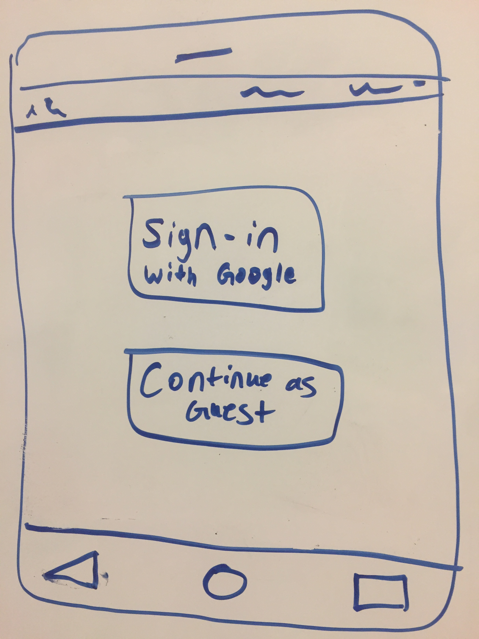
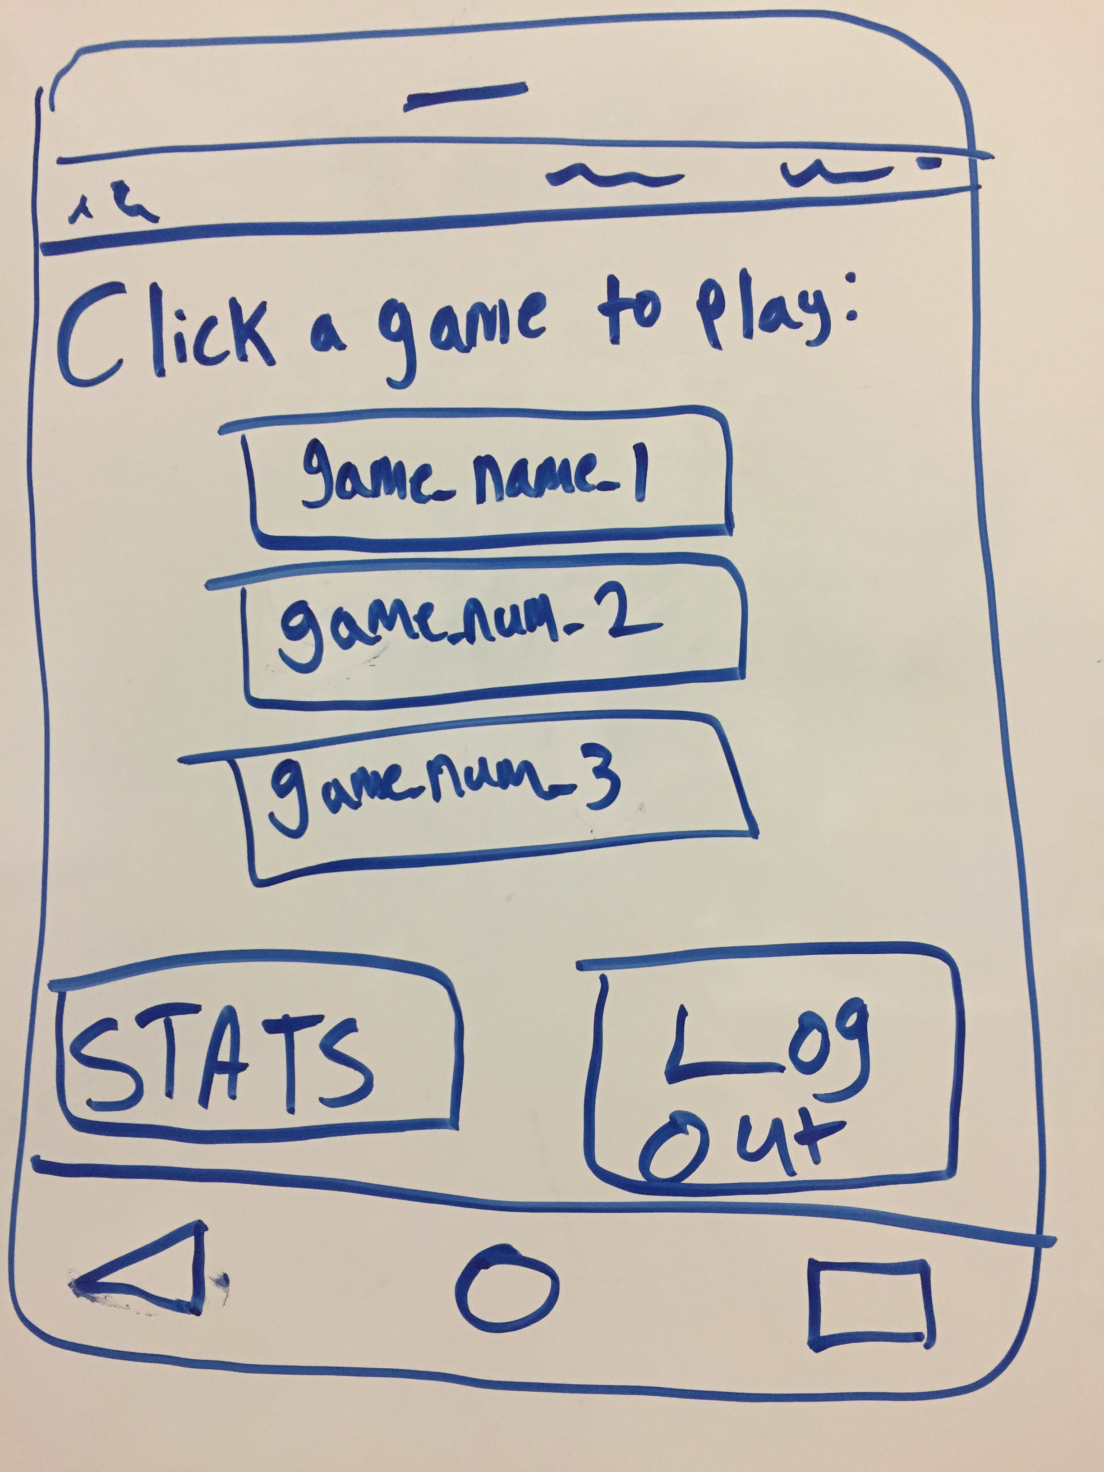
Rough Draft
Welcome view:
View after signing in:
Within one main vertical layout:
A text view
Vertical Scroll View of game Buttons
Horizontal Linear Layout of Stats and Log Out button on bottom
NOTE: Upon clicking a game, a toast message will appear to tell the user, “press the back button to return to the home screen”

Slide 7
Planned Timeline
Week 1 (3/12-3/16): First App (simple)
Weeks 2-3 (3/19-3/30): Second App (implement Unity)
Weeks 4-5 (4/2-4/13): Third App (exploration)
Week 6-7 (4/16-4/27): Combine games into single app, implement support for individual users (connect to Google Accounts), create lobby, create statistics page
Week 8 (4/30-5/4): Testing/Final Touches

Slide 8
Expected Deliverables and End Product
Realistically: An app with multiple games of different levels of complexity that take advantage of multiple phone features.
Key components of the end product:
Fully usable
Aesthetically pleasing with clear design intent
Easy to use for the user
No one cares what I make unless they can easily use it themselves
Speed is important
Implementing “cool” or “exciting” features doesn’t matter if the underlying app doesn’t function properly, thus I will focus on first achieving a minimum viable product for each game

